Slide 1


A TRUSTED INNOVATION PARTNER
Defining digital strategy and adopting the right technology to transform.
THE TEN WHY’S SMALL TO MIDSIZED LOCAL GOVERNMENTS MUST UTILIZE DIGITAL SOLUTIONS
Digital transformation in local governments
Central Keystone Council of Governments
October 16, 2024
VISION • To uplift communities through innovative digital solutions
MISSION • To be the most trusted partner for technology advice and services when organizations want to transform

Slide 2


THE TEN WHY’S SMALL TO MIDSIZED LOCAL GOVERNMENTS MUST UTILIZE DIGITAL SOLUTIONS
Digital transformation in local governments
Notes:
intro to the company
into the solutions
problems we are solving
why are different

Slide 3

Digitally Transforming Every Small To Mid-Sized
Local Government in the USA
Notes:
intro to the company
into the solutions
problems we are solving
why are different

Slide 4
Our Goal
Vision
Mission
We are on a mission to digitally transform every small to mid-sized local government in the USA with our innovative digital solutions.
To uplift one community at a time through innovative digital solutions.
Our team of experts empowers you to transform your government with innovative digital solutions so that you can enrich the lives of your constituents.
Our Values
Inclusivity – Quality – Integrity – Leadership – Passion – Responsibility.
Our expertise spans over 75 years of combined experience
3
110+
Successfully served millions of citizens with excellence
Offices worldwide
Diverse Employees

Slide 5
MISSON
Digitally Transforming small to midsized local governments in the USA one local government at a time.
      Digitally transforming small to midsized local governments in the USA by providing intuitive, innovative, customizable and secure products and associated services combined with best-in-class clients’ experience for creating value to all stakeholders through Operational efficiency, Service excellence and Enriching citizens and staff experience.

Slide 6

Objectives
Understanding Digital Transformation
Challenges facing small to midsized local governments
Challenges facing small to midsized local governments in embarking on digital transformation journey
Digital transformation in local governments
6 ways small to midsized local governments can utilize digital solutions
6 why’s for small to midsized local governments to utilize digital solutions

Slide 7
Challenges facing small to midsized local governments
Constituents expect their local government to sort out complexity and make services intuitive and convenient.
Local governments face growing public demand for services, and unprecedented cuts in expenditures.
Employees’ expectations for innovative digital solutions are increasing
Attracting new talents
Elected officials are demanding efficiency and effectiveness.
Demographical shifts and millennials getting into the workforce are creating enormous pressure.
Social, environmental, health, and economic challenges compound the demand for innovative solutions.
Digital innovations taking place outside the local governments are adding pressure.
Digital risks are undermining the confidence and trust in the governments.
Organizational silos are impeding on productivity, service delivery, growth, and quality of life for constituents.
Mounting external threats such as cyber-attacks, deceases, frequency and severity of natural disasters

Slide 8
Challenges facing small to midsized local governments
“Small to midsized local governments deliver multiple services, expected to comply with regulations, transform their communities, provide enriching experience to their citizens, maintain infrastructure, etc. as the bigger local governments but small to midsized local governments are expected to deliver all these and achieve their outcomes for very low level of resources than the larger ones.”
“Big city problems, to be solved with small city budgets”

Slide 9
Understanding Digital Transformation
“Digital Transformation must be at the heart of every organization” - Gartner

Slide 10
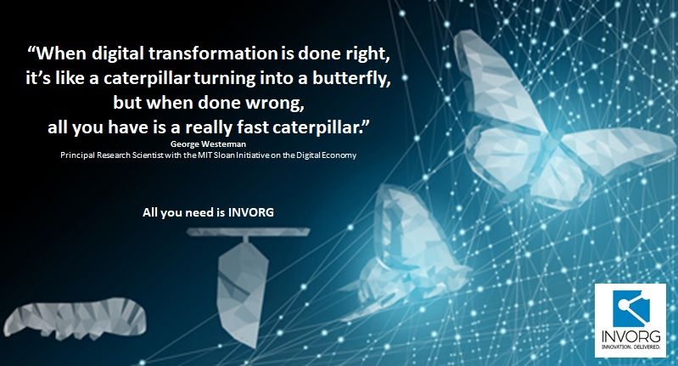
Understanding Digital Transformation
The role of digital transformation in transforming local governments into a constituent centric local government.
“We are no longer pinning for digital transformation to become part of our lives. It’s right here, either jump in and play along or we get out of business” - Moses Nathan Muhanji
Transformation is a journey…Not an event.

Slide 11
Understanding Digital Transformation
Digitization
Digitalization
Digital Transformation
“The biggest part of digital transformation is changing the way we think.”
Simeon Preston
“Digital transformation marks a radical rethinking of how an organization uses technology, people and processes to fundamentally change business performance” - - George Westerman, MIT principal research scientist and author of Leading Digital: Turning Technology Into Business Transformation.

Slide 12

Digital transformation in local governments
Transforming every community in the USA
Notes:
intro to the company
into the solutions
problems we are solving
why are different

Slide 13
Digital transformation in local governments
“By 2022, half of all digital government key performance indicators will include a citizen/customer experience metric to ensure that services delivered are citizen-centric.” - Gartner
“Constituents must be at the center of local governments”

Slide 14
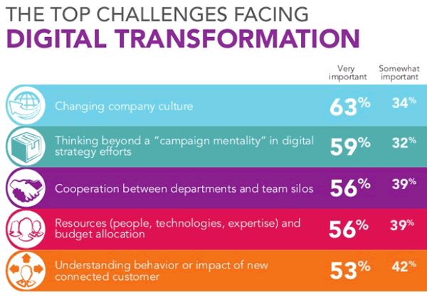
Digital transformation in local governments
70% of all digital transformation initiatives do not reach their goals.
Of the $1.3 trillion that was spent on DT in 2019, it was estimated that $900 billion went to waste.
HBR

Slide 15
Digital transformation in local governments
“Implementing Digital solutions must begin with understanding the local government outcomes to be achieved than the technology to be implemented.”
How will we as a local government engage our citizens?
How will we empower our employees?
How can we optimize existing processes and make them automated with technology?
How will we transform our brand and improve or reinvent the services we provide?
How could we improve the value to our citizens?
How could we improve our citizen’s experience?

Slide 16



Digital transformation in local governments
Improving Accountability and Transparency
Improving Compliance
Breaking down organizational “silos”
Improving Citizens Engagement and Experience
Improving staff experience and morale
Attracting new talents
Improving the quality of life for their citizens and enabling growth
Enabling JITC ( Just in Time Communication)
Transforming Services
Optimizing and automating processes
Improving Data Quality
Improving the quality and timeliness of decision making
Optimizing resource utilization and reducing the cost of delivering services
Making local government services available anytime, anywhere
Reducing the cost of “keeping the lights on”
Improving risk management and reducing the cost associated with risks
Enriched Citizens Experience
Empowered Staff
Enhanced financial capability
Optimized
operations
Innovative organizational culture

Slide 17
The Ten WHY’s for small to midsized local governments to utilize digital solutions
To improve Citizens Engagement & Experience
To Improve staff experience and morale
To optimize resource management and utilization
To reduce the cost of delivering services
To improve accountability and transparency
To improve communication & collaboration
To protect critical assets being destroyed
To improve the quality of decision and timeliness of decision making
To protect security and privacy of data
To align and optimize resources citizens need
Digital Solutions such as MuniLogic, MuniCitizen, OptimoGov, etc. are transforming local governments

Slide 18
The Ten WHY’s for small to midsized local governments to utilize digital solutions
To Improve Citizens Engagement & Experience
  Share their ideas and suggestions
  Report issues and problems from anywhere, anytime.
  Obtain services /information from anywhere, anytime.
  Engage with their local governments to participate in community activities, etc.
Digital Solutions such as MuniLogic, MuniCitizen, OptimoGov, etc. are transforming local governments

Slide 19
The Ten WHY’s for small to midsized local governments to utilize digital solutions
Digital Solutions such as MuniLogic, MuniCitizen, OptimoGov, etc. are transforming local governments
To improve staff experience and morale
  Access to accurate and timely data to make informed decisions, provide best in class services
  Access to data from anywhere, anytime to carry out their roles and responsibilities
  Ability to communicate and collaborate with internal and external stakeholders in an effective and efficient manner

Slide 20
The Ten WHY’s for small to midsized local governments to utilize digital solutions
Digital Solutions such as MuniLogic, MuniCitizen, OptimoGov, etc. are transforming local governments
To optimize resource management and utilization
  Ability to have accurate data about their assets and other resources to manage their assets effectively, efficiently, and economically
  Ability to make informed decisions about asset utilization, assets replacements, etc.
  Ability to allocate and utilize resources optimally to provide maximum value to stakeholders

Slide 21
The Ten WHY’s for small to midsized local governments to utilize digital solutions
Digital Solutions such as MuniLogic, MuniCitizen, OptimoGov, etc. are transforming local governments
To reduce the cost of delivering services
  Ability to assign resources in an optimal manner
  Understand the service utilization by citizens to eliminate low value services
  Ability to plan services based on citizens needs

Slide 22
The Ten WHY’s for small to midsized local governments to utilize digital solutions
Digital Solutions such as MuniLogic, MuniCitizen, OptimoGov, etc. are transforming local governments
To improve accountability and transparency
  Ability to provide service level information to citizens
  Ability to develop key performance indicators to measure, manage and improve performance
  Ability to share resource data and other forms of information with citizens on a timely manner

Slide 23
The Ten WHY’s for small to midsized local governments to utilize digital solutions
Digital Solutions such as MuniLogic, MuniCitizen, OptimoGov, etc. are transforming local governments
To improve communication
  Ability to provide accurate information to the right stakeholders at the right time leveraging the right channels
  Ability to provide targeted information than just volume of information
  Ability to communicate just in time service information

Slide 24
The Ten WHY’s for small to midsized local governments to utilize digital solutions
Digital Solutions such as MuniLogic, MuniCitizen, OptimoGov, etc. are transforming local governments
To protect critical assets being destroyed and reduce ever increasing storage cost

Slide 25
The Ten WHY’s for small to midsized local governments to utilize digital solutions
Digital Solutions such as MuniLogic, MuniCitizen, OptimoGov, etc. are transforming local governments
To improve the quality of decision and timeliness of decision making

Slide 26
Digitally Transforming Every Small To Mid-Sized
Local Government in the USA
Notes:
intro to the company
into the solutions
problems we are solving
why are different

Slide 27
Our Goal
Vision
Mission
We are on a mission to digitally transform every small to mid-sized local government in the USA with our innovative digital solutions.
To uplift one community at a time through innovative digital solutions.
Our team of experts empowers you to transform your government with innovative digital solutions so that you can enrich the lives of your constituents.
Our Values
Inclusivity – Quality – Integrity – Leadership – Passion – Responsibility.
Our expertise spans over 75 years of combined experience
3
110+
Successfully served millions of citizens with excellence
Offices worldwide
Diverse Employees

Slide 28

The MuniLogic Difference
  Expertise in Local Government: We understand local government needs and challenges and tailor our solutions accordingly.
  Affordable Solutions: We provide high-quality solutions that fit your budget without compromising on effectiveness, ensuring exceptional value.
  User-Centric Solutions: Our MuniCitizen platform offers a user-friendly interface for both officials and residents.
  Proven Success: We’ve enhanced citizen satisfaction, efficiency, and transparency in many municipalities.
  Exceptional Support: 24/7 support ensures you get the most out of our platform.
  Flexible and Scalable: Our platform grows with your township’s needs.
  Top-Notch Security and Compliance: We uphold the highest standards for data protection and regulatory compliance.
  Exceptional ROI: Our cost-effective solutions provide measurable outcomes, ensuring your investment yields significant long-term value.

Slide 29
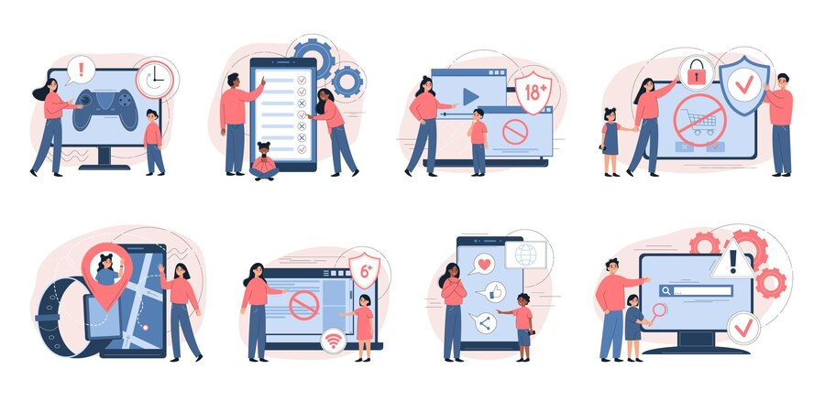
Our Products & Services
Our Services
  Digital Transformation Consulting
  CIO as Service
  GIS Consulting
  Digital Risk Management Consulting
  Custom Solutions Development
  Muni Automate & Muni Insights
Featured Products
  MuniLogic CE
  MuniCitizen
  iRisk Management
  Muniforms
  MuniDex

Slide 30
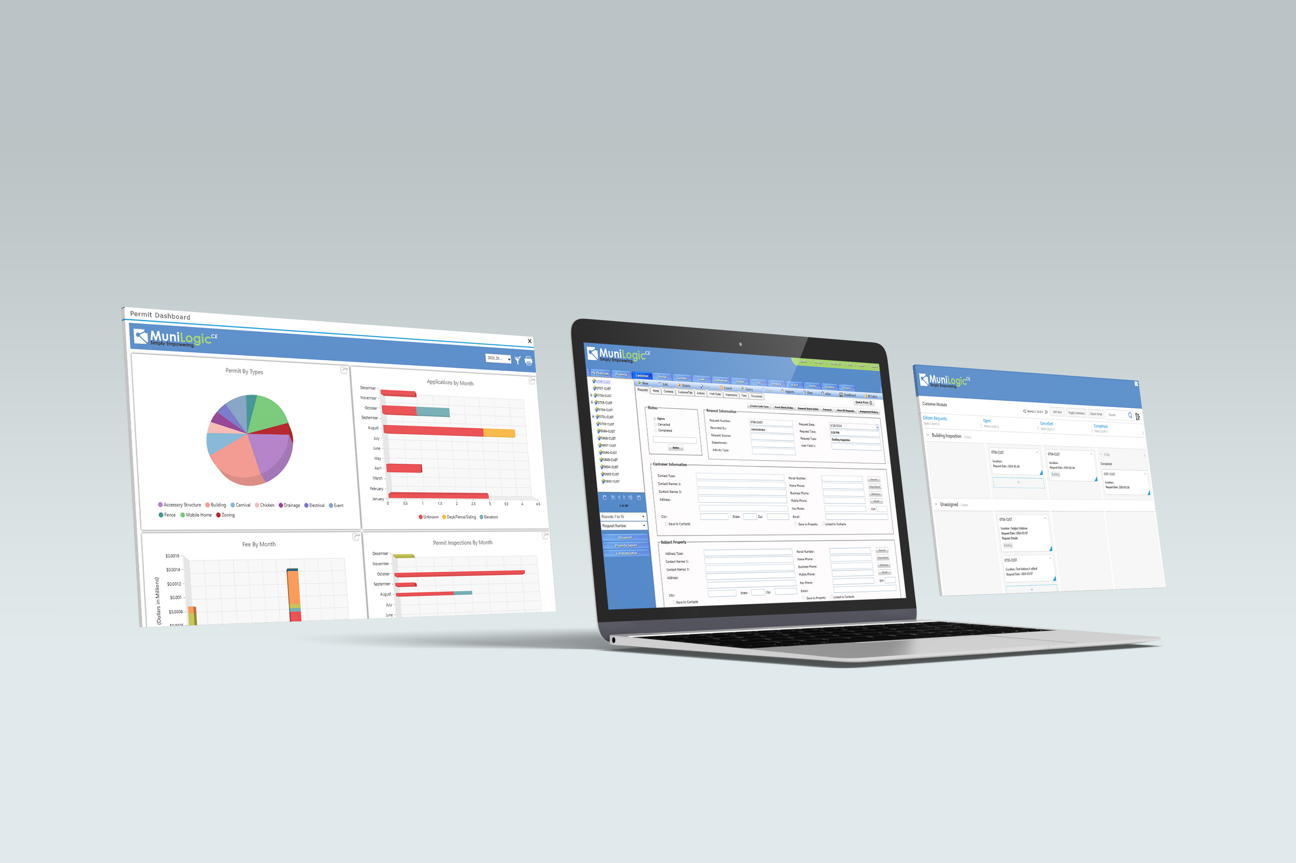

Our Products & Services
MuniLogic CE
MuniLogic CE is a comprehensive digital platform tailored to help local governments streamline operations and improve efficiency. It features essential core modules that manage municipal activities, including property management, effective communication tools, robust reporting capabilities, secure document management, a centralized calendar for scheduling, and integrated GIS mapping for enhanced planning. In addition to these core functions, MuniLogic CE offers a range of additional modules that enhance functionality, including

Slide 31
MuniLogic CE
  Code: Facilitate code enforcement to uphold community standards.
  License: Manage licenses efficiently from application to renewal.
  Permit: Simplify the permitting process to reduce administrative burdens.
  Zoning: Manage zoning activities to ensure compliance with regulations.
  Inspections. Manage all inspections, violations, notifications, schedules,
  and communications.
  Subdivision: Streamline the approval process for subdivisions.
  Storm: Oversee stormwater management and environmental compliance.
  Water: Manage water resources sustainably.
  Sanitary: Track and manage sanitary services for public health.
  Tax: Centralize tax management for streamlined revenue collection.
  Roadway: Manage roadway infrastructure for safe transportation networks.
Additionally, the Customer Module is now included at no additional cost with implementing the MuniLogic CE core system.

Slide 32
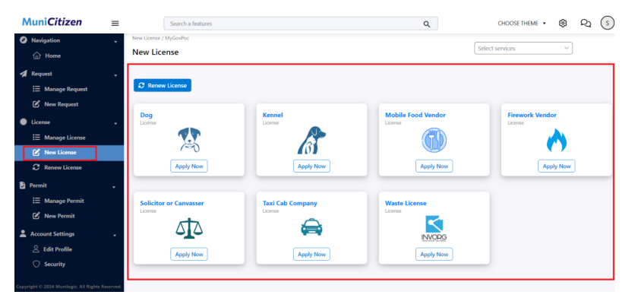
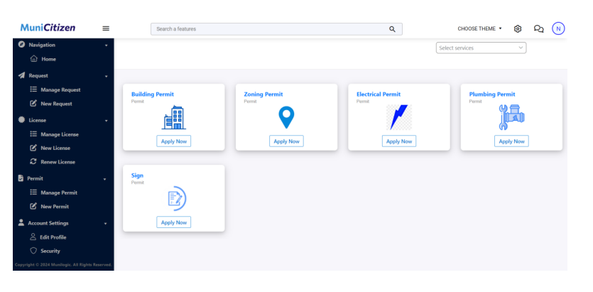
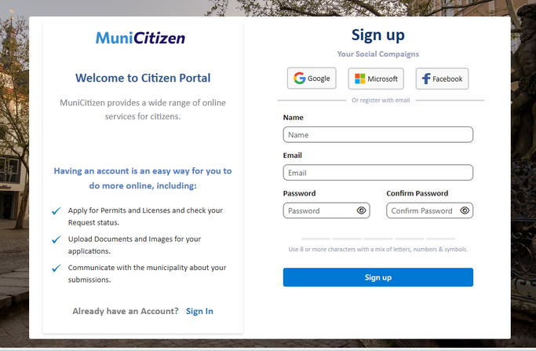
MuniCitizen
MuniCitizen is a state-of-the-art extension of the MuniLogic CE platform, designed specifically to empower citizens and local governments with innovative digital capabilities. The solution aims to facilitate service delivery and enhance citizen engagement by providing a user-friendly online interface for accessing government services.

Slide 33

Digitally Transforming Every Small To Mid-Sized
Local Government in the USA
Trusted Partner – Guaranteed Results
Let us uplift the community together by leveraging innovative solutions.

